Slide 1

Sigma Receptors (Sig R): Novel Targets of Neuropsychotherapeutic Drugs
Naleeka Randani

Slide 2

Theme
DMT ameliorates the adverse effects of cellular stress in hypoxia by activating sigma-1 receptors.

Slide 3
Sub-Theme
Activation of sigma-1 receptors modulate anxiety and depression related behaviors

Slide 4
Characters
Sigma-1 receptors (Sig-1R)
Neural Protection
Head twitch response
Antidepressant

Slide 5
Hypothesis
DMT acting on Sigma-1 receptors have antidepressant effects

Slide 6
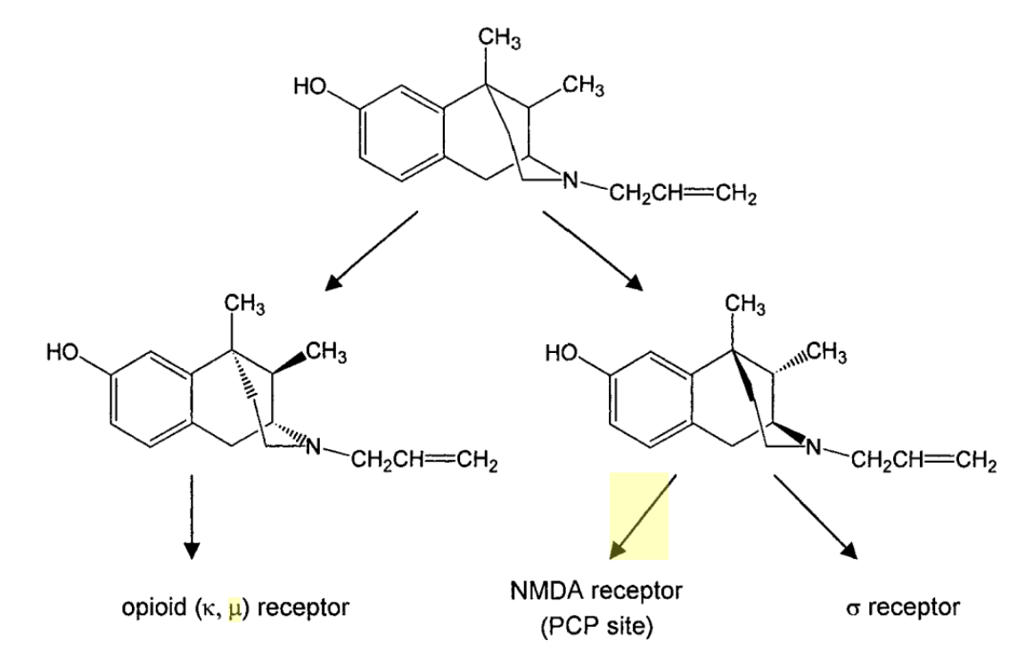
Historical Perspective
First proposed in 1976 by Martin and his colleagues.
SKF-10,047 (N-allylnormetazocine)
(Martin et al., 1976)

Slide 7
Historical Perspective
Studies by Tsung-Ping Su and William Tam
Identification of selective radioligands
DTG (Diotolylguanidine)
  Pentazocine
Cloning of the first Sig-R by Hanner et al. (1996)
    Insights about the structure and function of receptors
    A protein with 223 amino acids
    90% sequence conservation in many mammalian species
(Duncan and Wang, 2005)

Slide 8
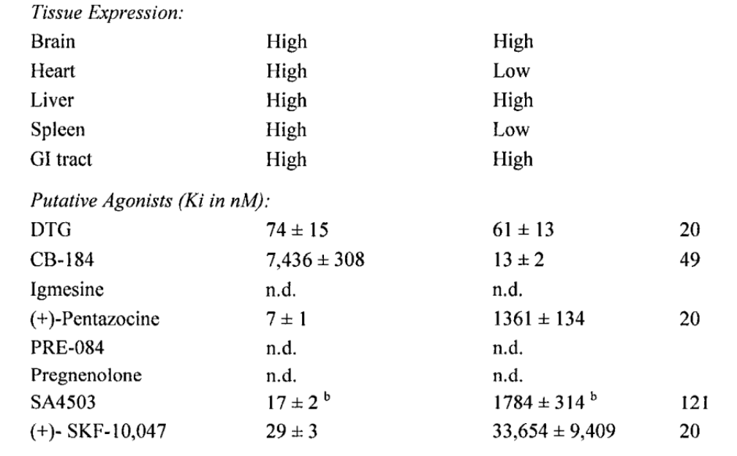
Subtypes
Two well established subtypes
  Sig-1R
  Sig-2R
Additional subtypes
  Sig-3R
Sig-1R Sig-2R
Hellewell et al., 1994)

Slide 9
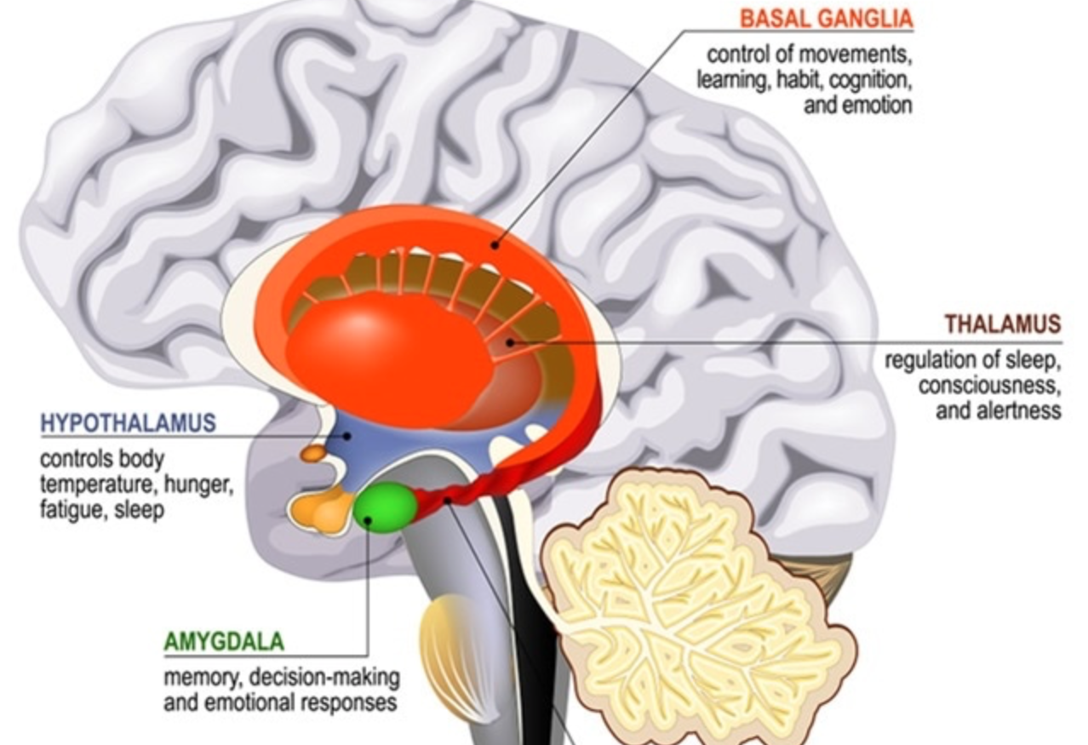
Anatomical Distribution of Sig-1R
Sig-R present throughout the body
  CNS: Expressed in the hippocampus, amygdala, cerebellum, basal ganglia and spinal cord ( Seth et al., 1998).
  Peripheral organs: Heart, lung, liver, kidney, gut
  Cell types: Leukocytes, granulocytes, lymphocytes, and natural killer cells

Slide 10
The Oligomerization of Sig-1R
(Yang et al., 2019)

Slide 11
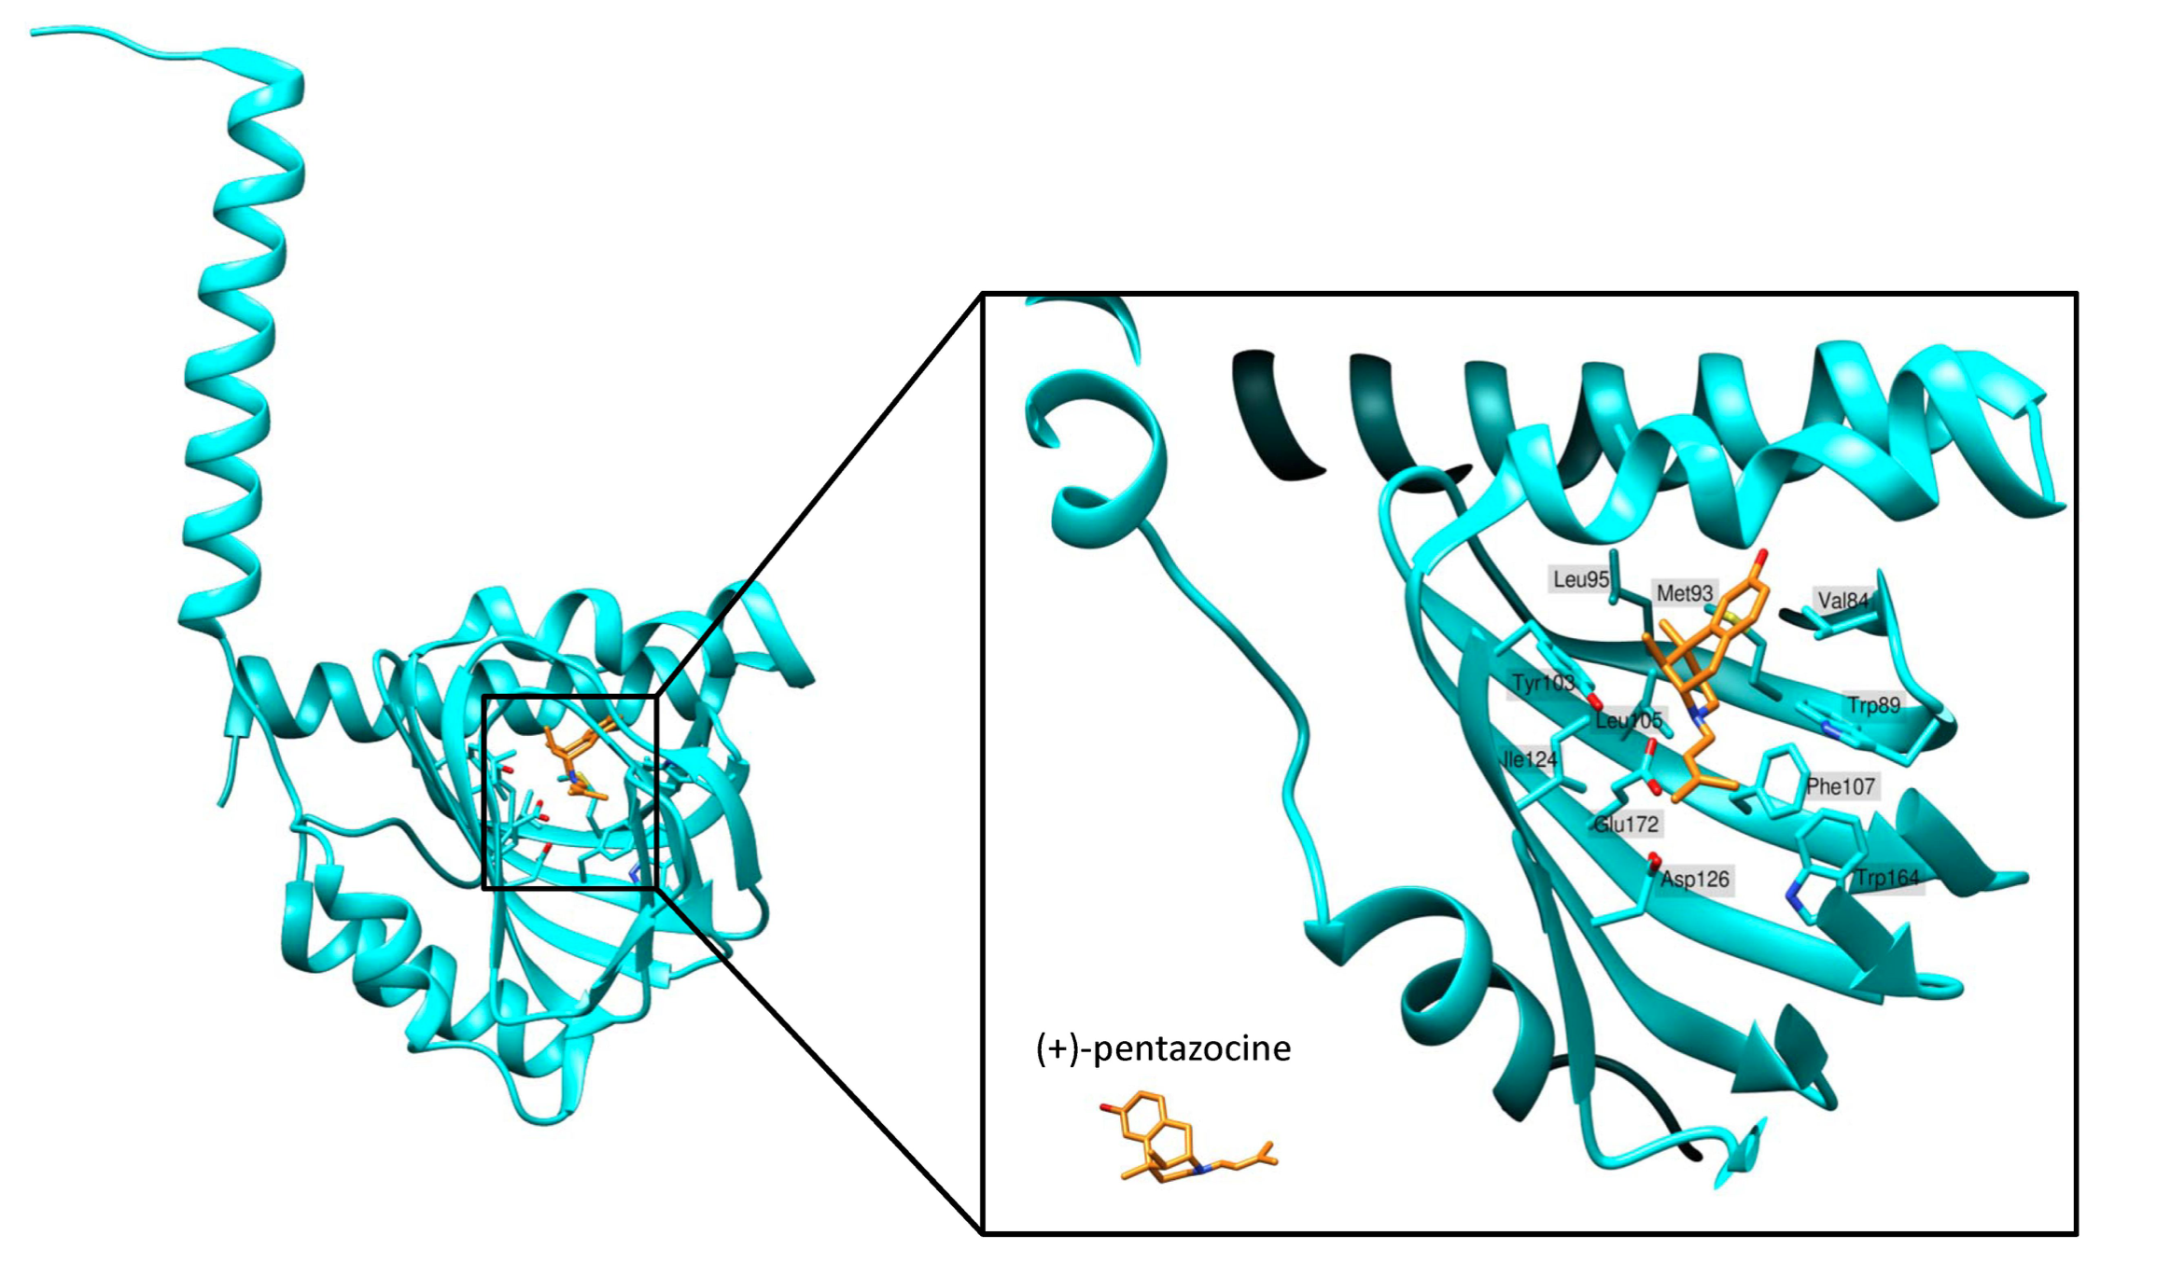
Sig-1R ligands
(Uyen et al., 2015)

Slide 12
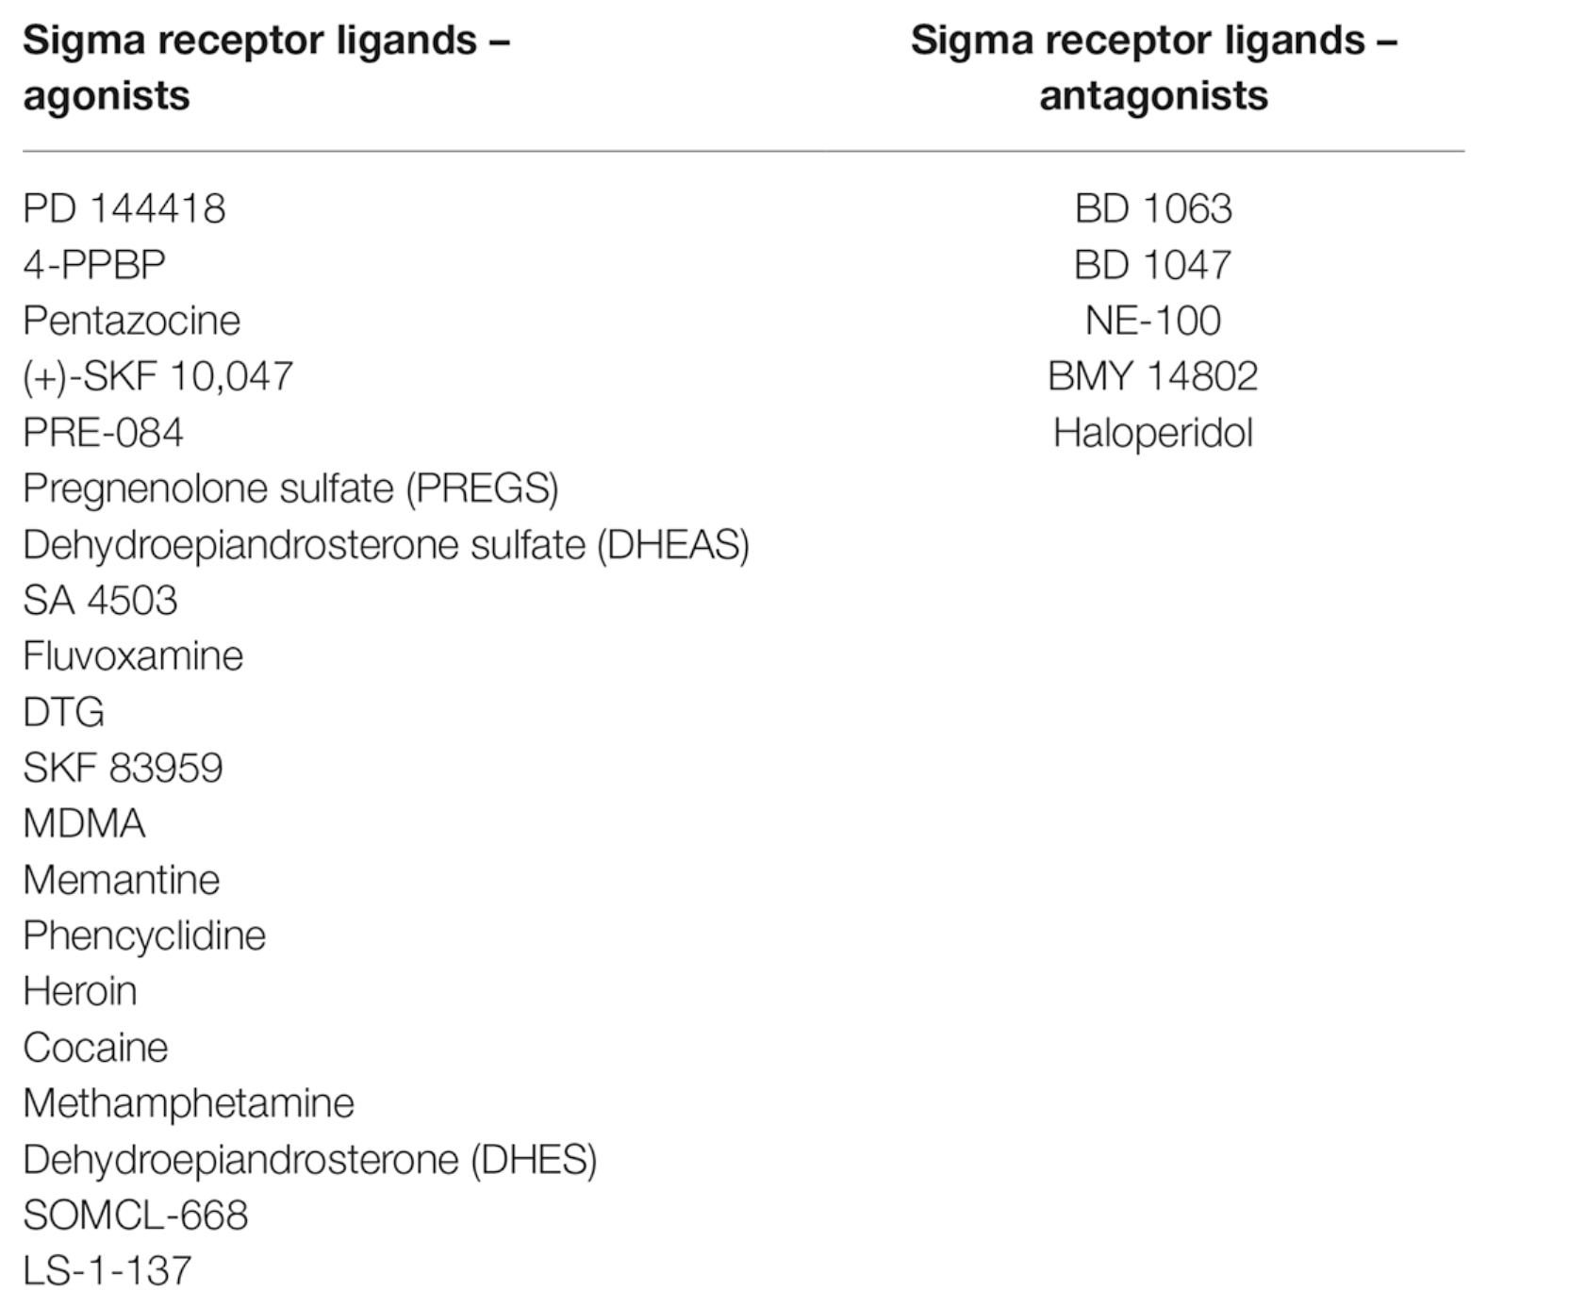
Sig-1R ligands
(Uyen et al., 2015)

Slide 13
Physiological roles of Sig-1R in the CNS
Neuronal Excitability
Synaptic plasticity, learning and memory
Neuroprotection
Modulation of Endoplasmic reticulum stress
Modulation of calcium homeostasis and glutamate toxicity
Modulation of Neuroinflammation

Slide 14
Sig-1R Roles: Modulation of Neurophysiology
(Ryskamp et al., 2019)

Slide 15
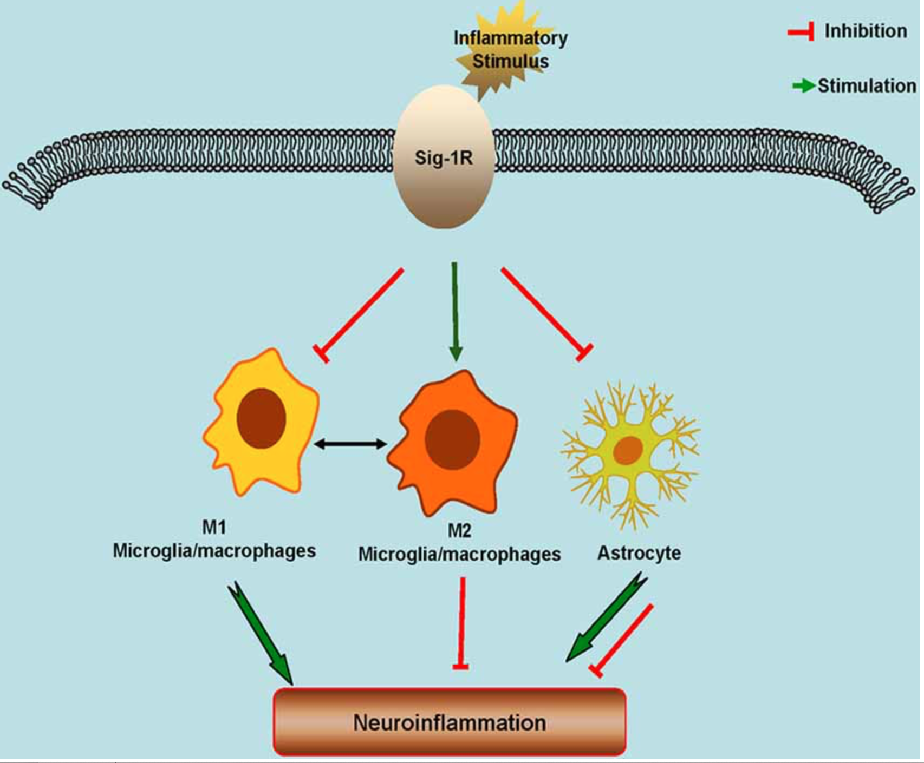
Sig-1R Roles: Neuroinflammation
(Jia et al., 2018)

Slide 16
Sig-1R Roles: Therapeutic mechanism for Sig-1R agonists
Hashimoto, 2013

Slide 17
Sig-1R Roles: Neurogenesis
Fukunaga and Moriguchi, 2017)

Slide 18
Relationship between oxidative stress and ER stress
(Chong et al., 2017)

Slide 19
What happen during Hypoxia??
(Bickler and Donohoe, 2002)

Slide 20
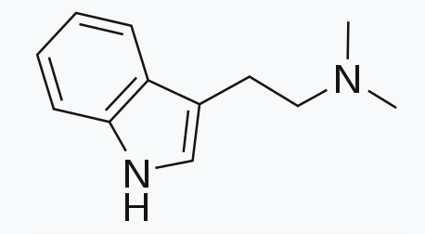
DMT (N,N-dimethyltryptamine)
Endogenous Sig-1R regulator
Psychoactive snuffs (yopo) and sacramental teas (ayahuasca) of South American natives.
Found in human urine, blood and cerebrospinal fluid
Production increases in rodent brain under environmental stress.
Rapid onset, intense effects and short duration of action.

Slide 21


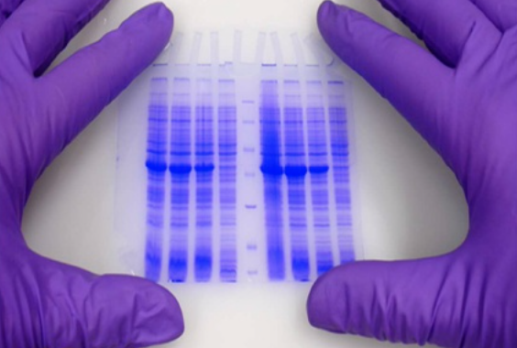
Methods
Isolation of cells
Induction of Hypoxia
DMT treatment of cells
RNA isolation
Western blotting
Cellular viability assays
RNA interference

Slide 22
DMT treatment on the survival of human iPSC-derived cortical neurons
In vitro administration of 10–200 μM DMT increases the survival of iPSC-derived cortical neurons

Slide 23
DMT treatment on the survival of Monocyte-derived macrophages
Significant amounts of apoptotic cells could be detected only after 6 h of hypoxia

Slide 24
DMT treatment on the survival of Dendritic cells
Significant amounts of apoptotic cells could be detected only after 6 h of hypoxia

Slide 25
The effect of Sig-1R gene silencing on the DMT-mediated cell survival
Specific silencing of the Sig-1R gene resulted in downregulation of the Sig-1R protein in all cell types as compared to non- transfected and scrambled siRNA controls

Slide 26
Effect of Sig-1R knockdown on cell viability
Specific silencing of Sig-1R abrogated the modulatory potential of DMT on the survival of all cell types

Slide 27
Effect of Sig-1R knockdown on cell viability

Slide 28

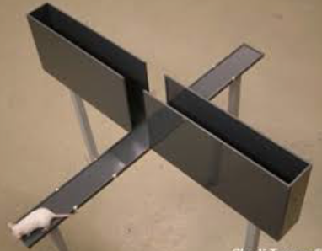
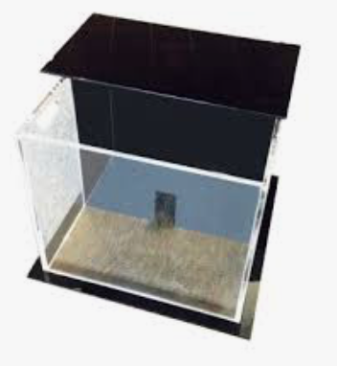
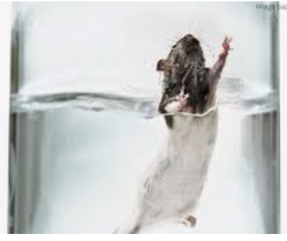
Sig-1R knockout mice display a depressive phenotype: Methods
Tests performed
Light-dark transfer test
Elevated plus-maze test
Forced swim test

Slide 29
Results
No significant genotype effects were found in the % of time spent in the light compartment of the apparatus, in the latency to first enter into the light compartment or in the total number of transitions between compartments

Slide 30
Elevated plus maze test
No significant genotype effects were found in the % of time spent on the open arms (measure of anxiety-like behavior), or in the number of entries into the closed arms (measure of non-specific motor activity).

Slide 31
Forced swim test
Significantly greater immobility and less swimming than WT mice (depressive phenotype) and Sig-1R KO and WT showed similar levels of climbing

Slide 32
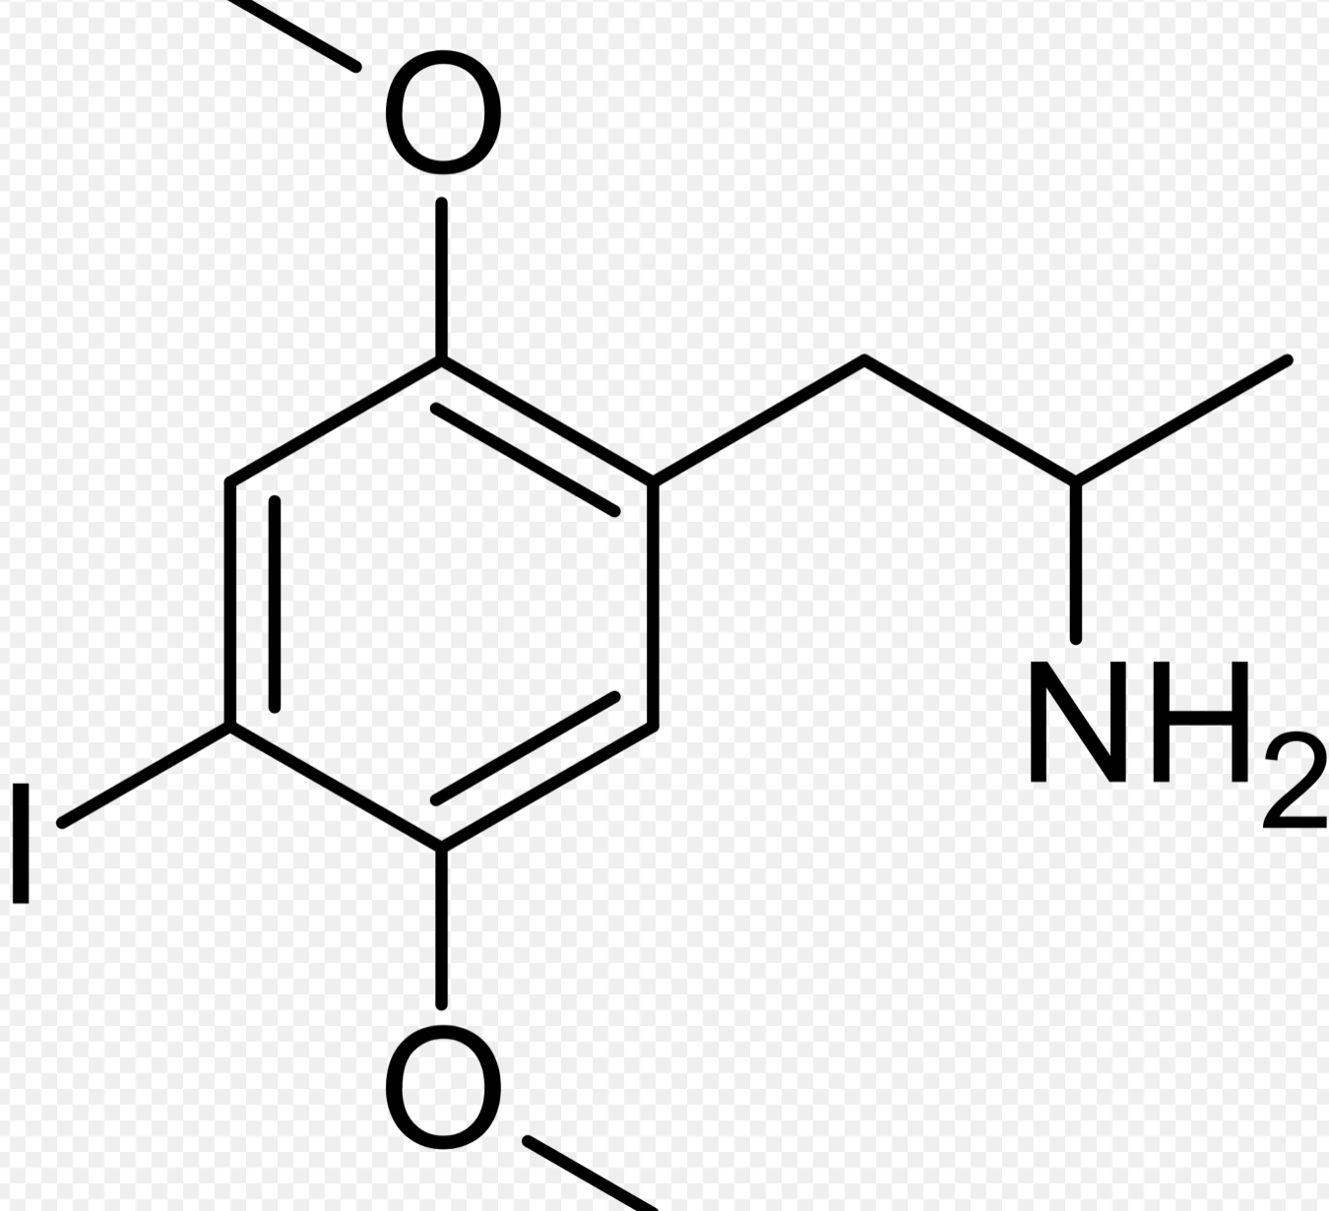
DOI (2,5-dimethoxy-4-iodoamphetamine)
High affinity at serotonin 5-HT2 receptor subtypes
Full agonist- 5-HT2A
Partial agonist- 5-HT2C
Indicator of the presence of serotonin receptors
Selective function
Induce a head twitch response (HTR) in mice

Slide 33
HTR under DOI and Haloperidol
Haloperidol rapidly attenuated the frequency (number of twitches/unit of time) of the DOI-induced HTR.

Slide 34
Effect of Sig-1R agonists and antagonists on the DOI-induced HTR
The sigma-1 receptor antagonists haloperidol and BD1047 both attenuated the DOI-induced HTR when compared to their respective vehicle controls.

Slide 35
Conclusion
DMT-mediated Sig-1R modulation may contribute to neuro-regenerative and neurorestorative processes.
Sig-1Rs modulate depressive behavior and Sig-1R agonists act as potential therapeutics for depressive disorders.

Slide 36
Therapeutic potential of Sig-1R
As a treatment for
    Depression (MDD and PD)
    Anxiety
    Surgery
    Old people with emphysema

Slide 37
THANK YOU

